Slide 1


SAFESCREEN: AI-POWERED CHILD PROTECTION WITH INSTANT CONTENT REDIRECTION
PROJECT VIVA VOCE on 09/01/2025
Presented By
BAVYA SRI.V (211161010)
IVANJALIN.A (211161017)
PRAVIN.B (211161034)
THAMIZHMANI.V (211161052)
VII – Sem B.Tech AI&DS
Guided By
Dr.S.Ananth,M.E.,MBA.,Ph.D..
HEAD OF THE DEPARTMENT
DEPARTMENT OF ARTIFICIAL INTELLIGENCE AND DATA SCIENCE
MAHENDRA ENGINEERING COLLEGE
(AUTONOMOUS)
MAHENDRAPURI, NAMAKKAL Dt-637 503
09/01/2025
MEC-VII Sem. AI&DS-Project Work (Phase-I)
Viva Voce-Jan-2025
1

Slide 2
OVERVIEW
Abstract
Domain Introduction
Existing System and It’s Disadvantages
Proposed System and It’s Advantages
System Requirements Specification
Data Flow Diagram
System Architecture
Modules
Conclusion
Reference
09/01/2025
MEC-VII Sem. AI&DS-Project Work (Phase-I)
Viva Voce-Jan-2025
2

Slide 3
ABSTRACT
Safe Screen is an AI - powered solution ensuring children's online safety by analyzing and redirecting harmful content in real-time.
It uses advanced machine learning and NLP to scan and intervene in various digital media, providing age-appropriate alternatives seamlessly.
Parents can customize filters and access detailed usage reports to monitor and manage their child’s online behavior effectively.
09/01/2025
MEC-VII Sem. AI&DS-Project Work (Phase-I)
Viva Voce-Jan-2025
4

Slide 4
DOMAIN INTRODUCTION
Deep learning uses multi-layered artificial neural networks to mimic human brain functionality for complex data processing. It requires large datasets and computational power to effectively learn patterns and make accurate predictions.
Deep learning is widely applied in image recognition, natural language processing, healthcare diagnostics, and autonomous systems.
Popular frameworks like TensorFlow, PyTorch, and Keras are used for developing and deploying deep learning models.
09/01/2025
MEC-VII Sem. AI&DS-Project Work (Phase-I)
Viva Voce-Jan-2025
3

Slide 5
EXISTING SYSTEM
Many parental control solutions use keyword-based filtering to block access to inappropriate websites and content.
Traditional methods rely on manual tracking of children's online activities and provide periodic reports to parents.
Current systems often lack intelligent content redirection to educational resources and may not effectively adapt to new and emerging online threats.
Disadvantages of Existing Systems
Ineffective for Live Content.
Limited Adaptability.
False Positives and Negatives.
Focus on Blocking Instead of Redirecting.
09/01/2025
MEC-VII Sem. AI&DS-Project Work (Phase-I)
Viva Voce-Jan-2025
5

Slide 6
PROPOSED SYSTEM
Employ machine learning algorithms to analyze and classify online content in real-time, ensuring effective filtering of inappropriate materials while adapting to new content trends.
Implement a mechanism that redirects children from harmful content to curated educational resources, promoting positive online engagement and learning.
Continuously monitor children's online activities and provide instant alerts to parents for concerning behavior or content, enabling proactive intervention.
Advantages of the Proposed System
Adaptive Content Filtering
Proactive Content Redirection
Real-Time Monitoring with Immediate Alerts
Contextual Understanding
09/01/2025
MEC-VII Sem. AI&DS-Project Work (Phase-I)
Viva Voce-Jan-2025
6

Slide 7
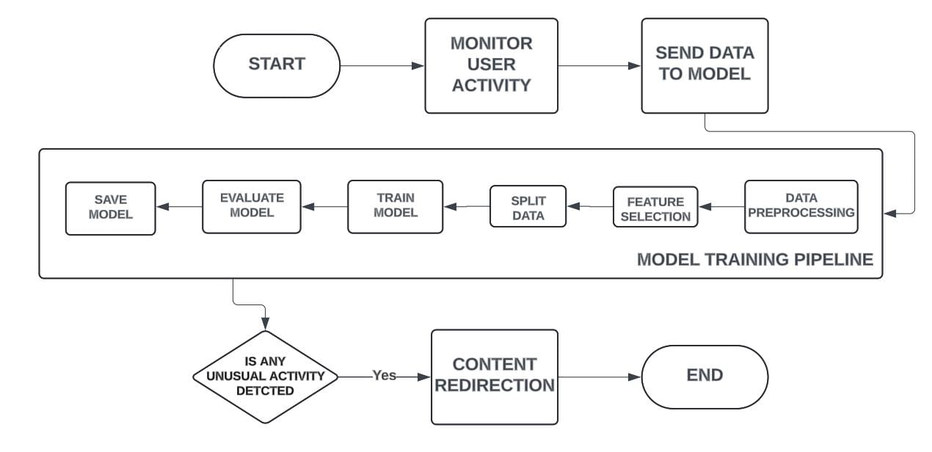
FLOW DIAGRAM
09/01/2025
MEC-VII Sem. AI&DS-Project Work (Phase-I)
Viva Voce-Jan-2025
7

Slide 8

SYSTEM REQUIREMENTS SPECIFICATION
MINIMUM HARDWARE REQUIREMENTS:
Processor : Intel i5 12th Gen, 2.00GHz
RAM : 8GB
Hard Disk : 512GB
MINIMUM SOFTWARE REQUIREMENTS:
Operating System : Windows 11
Software Tool & IDE : Visual Studio Code
Language : Python 3.6 or Higher
09/01/2025
MEC-VII Sem. AI&DS-Project Work (Phase-I)
Viva Voce-Jan-2025
8

Slide 9
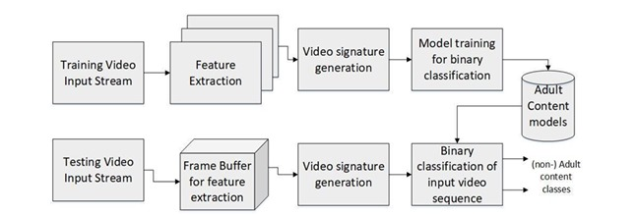
ARCHITECTURE
09/01/2025
MEC-VII Sem. AI&DS-Project Work (Phase-I)
Viva Voce-Jan-2025
9

Slide 10
MODULES
Module 1 : Data Loading & Processing
Module 2 : Train and Test Model
Module 3 : Algorithm
Module 3 : Screen Capture
Module 4 : Content Analysis
Module 5 : Content Redirection
09/01/2025
MEC-VII Sem. AI&DS-Project Work (Phase-I)
Viva Voce-Jan-2025
10

Slide 11
DATASET DATA PREPROCESSING
MODULE 1
Collect Data: Gather a diverse set of images, including both adult and non-adult content.
Label Data: Manually label the images as "adult" or "non-adult".
Split Data: Divide the dataset into training, validation, and test sets.
Preprocess Data: Resize images to a uniform size and normalize pixel values.
Augment Data: Apply transformations such as rotation, flipping, and cropping to increase dataset diversity.
09/01/2025
MEC-VII Sem. AI&DS-Project Work (Phase-I)
Viva Voce-Jan-2025
11

Slide 12
TRAIN MODEL AND TESTING
MODULE 2
We select a pre-trained model, like MobileNetV2, and modify its final layer to match the number of classes (e.g., "adult" and "non-adult"). The model is trained using a suitable loss function and optimizer, iterating over the training data to update the model weights and improve accuracy.
Once the model is trained, it undergoes through testing to evaluate its performance. Initially, the model is evaluated on the validation set, where metrics such as accuracy, precision, recall, and F1-score are calculated.
09/01/2025
MEC-VII Sem. AI&DS-Project Work (Phase-I)
Viva Voce-Jan-2025
12

Slide 13
MODULE 3
ALGORITHM
CNN :
Convolutional Neural Networks (CNNs) are deep learning algorithms designed to analyze visual
data like images.
Histogram of Oriented Gradients (HOG)
The Histogram of Oriented Gradients (HOG) method is used for detecting objects within images. This helps in recognizing patterns and structures, such as human figures, making it useful for identifying adult content.
Residual Networks (ResNets) are an advanced type of CNN that help in training very deep neural networks by using "residual connections" to skip certain layers. ResNets are known for their high accuracy in image recognition tasks.
Residual Networks (ResNets)

Slide 14
LIBRARIES USED
PyTorch: For building and training the AI model.
Flask: For setting up the web server.
html2canvas: For capturing the screen content.
numpy: For numerical operations.
pandas: For data manipulation.
sklearn: For performance evaluation metrics (accuracy, precision, recall, F1-score).
09/01/2025
MEC-VII Sem. AI&DS-Project Work (Phase-I)
Viva Voce-Jan-2025
13

Slide 15
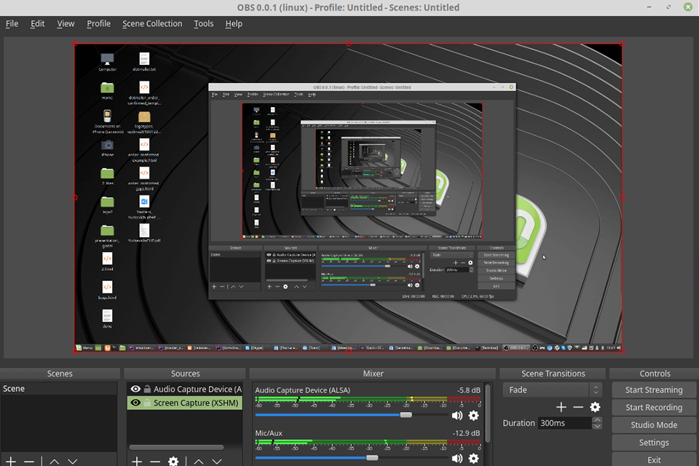
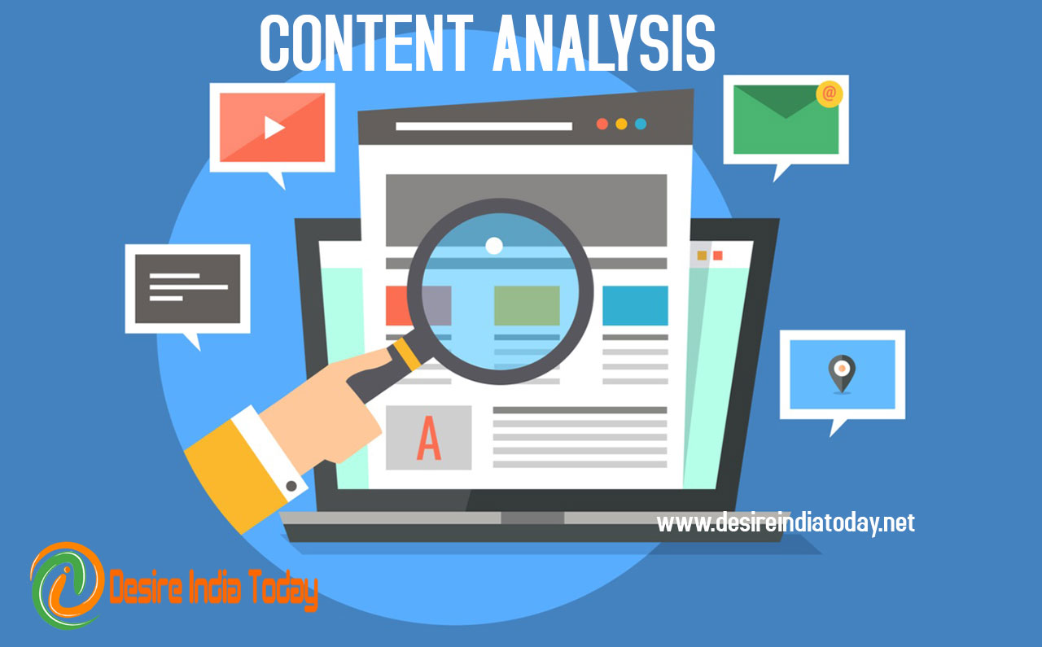

SCREEN CAPTURE The screen capture process involves taking snapshots of the current screen content at regular intervals. This is done using the Pytorch library, which captures the visual representation of the entire webpage. | MODULE 4 CONTENT ANALYSIS Once the screen content is captured, it is converted into an image format and sent to the server for analysis. The server uses a pre-trained AI model to analyze the content and determine if it contains any adult material. | CONTECT REDIRECT If the analysis determines that the content is inappropriate, the user is redirected to a safe page (e.g., a kids' game website). This ensures a safer browsing environment for children.
04/10/2024
MEC-VII Sem. AI&DS-Project Work (Phase-I)
Viva Voce-October-2024
9

Slide 16
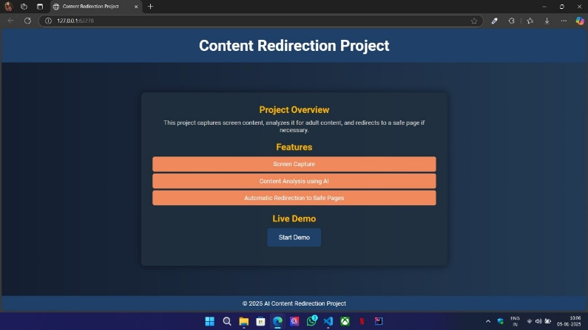
WEB PAGE
09/01/2025
MEC-VII Sem. AI&DS-Project Work (Phase-I)
Viva Voce-Jan-2025
14

Slide 17
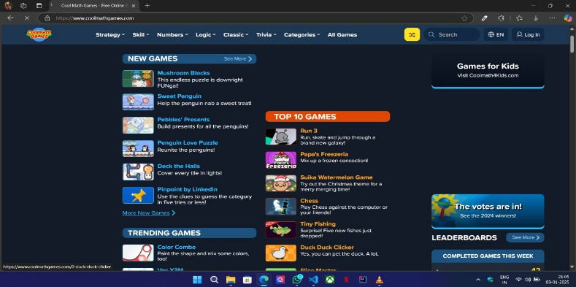
REDIRECTED SAFE PAGE
09/01/2025
MEC-VII Sem. AI&DS-Project Work (Phase-I)
Viva Voce-Jan-2025
15

Slide 18
CONCLUSION
Safe Screen uses AI and machine learning for real-time content analysis and redirection to age-appropriate alternatives, protecting children from harmful online content without interrupting their browsing experience.
The solution offers customizable filters and detailed usage reports, enabling parents to effectively monitor and manage their child's online activity, fostering a secure and enriching digital environment.
09/01/2025
MEC-VII Sem. AI&DS-Project Work (Phase-I)
Viva Voce-Jan-2025
16

Slide 19
REFERENCE
[1] Bishop, C. M. (2006). Pattern Recognition and Machine Learning. Springer.
[2] Bradski, G., & Kaehler, A. (2008). Learning OpenCV: Computer Vision with the OpenCV Library. O'Reilly Media.
[3] Dalal, N., & Triggs, B. (2005). Histograms of Oriented Gradients for Human Detection. Proceedings of the IEEE Conference on Computer Vision and Pattern Recognition (CVPR), 886–893.
[4] Goodfellow, I., Bengio, Y., & Courville, A. (2016). Deep Learning. MIT Press.
[5] He, K., Zhang, X., Ren, S., & Sun, J. (2016). Deep Residual Learning for Image Recognition. Proceedings of the IEEE Conference on Computer Vision and Pattern Recognition (CVPR), 770–778.
09/01/2025
MEC-VII Sem. AI&DS-Project Work (Phase-I)
Viva Voce-Jan-2025
17

Slide 20
Any Queries ?
09/01/2025
MEC-VII Sem. AI&DS-Project Work (Phase-I)
Viva Voce-Jan-2025
18

Slide 21
Thank you
09/01/2025
MEC-VII Sem. AI&DS-Project Work (Phase-I)
Viva Voce-Jan-2025
19

